Slide 1
Lecture 15
The Structure of the Urban Systems and the Laws of Geography
15.1 How Do Different People Migrate?
IUS 8.2.6
©Luís M. A. Bettencourt 2024
Notes:
In this module, we add a bit of detail about characteristics of migrants, and the fact that they are not an average person. This type of consideration is often missing from models (such as the one we just discussed), and it matters when we want to consider the growth (or decline) of cities. This differential movement is sometimes called “sorting” or “selection”, and it changes the character of places of origin and destination.

Slide 2
Who migrates?
Migrants are not an average person

Slide 3
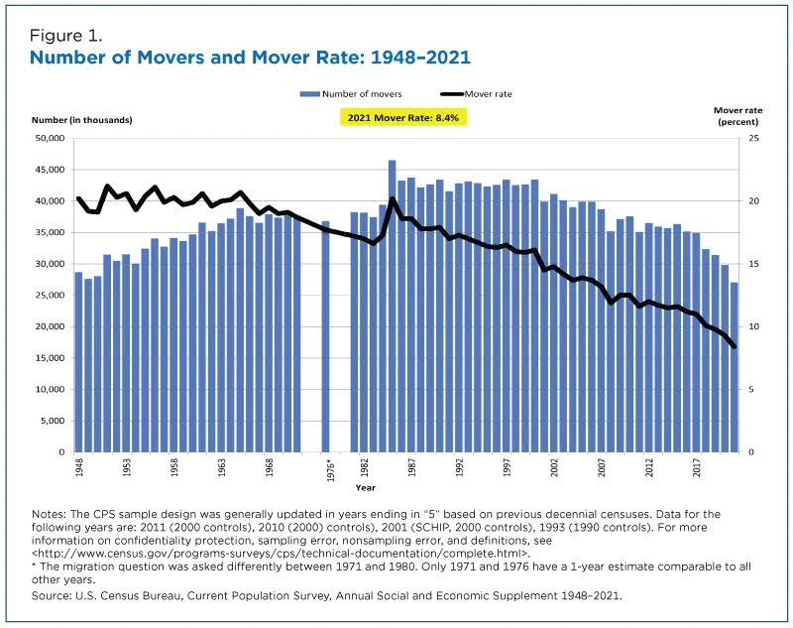
The great slowdown
https://www.census.gov/content/dam/Census/library/stories/2022/03/united-states-migration-continued-decline-from-2020-to-2021-figure-1.jpg
Notes:
An interesting - and perhaps counterintuitive - fact is that the rate of migration in the US has been steadily declining for decades. People used to migrate a lot more…

Slide 4
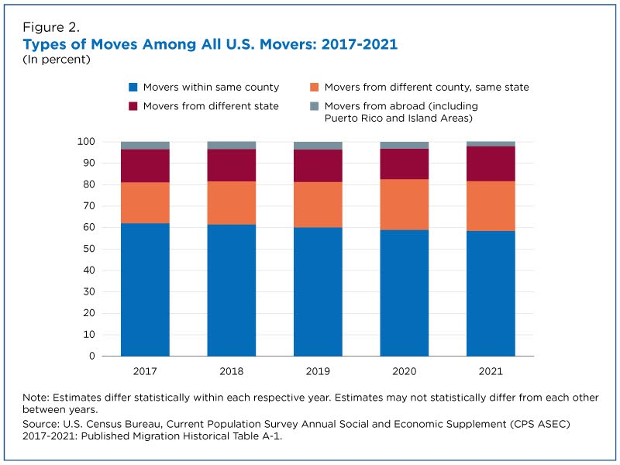
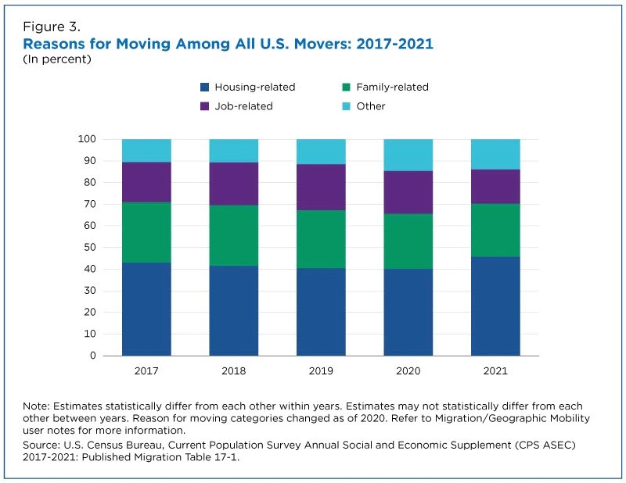
https://www.census.gov/content/dam/Census/library/stories/2022/03/united-states-migration-continued-decline-from-2020-to-2021-figure-2.jpg
Notes:
When people move, most moves are local. Also there are many reasons for moving, the main one being housing related. It is a myth without much foundations that jobs are the main driver of moves. They are cited as a direct reason for only 20-25% of cases.

Slide 5
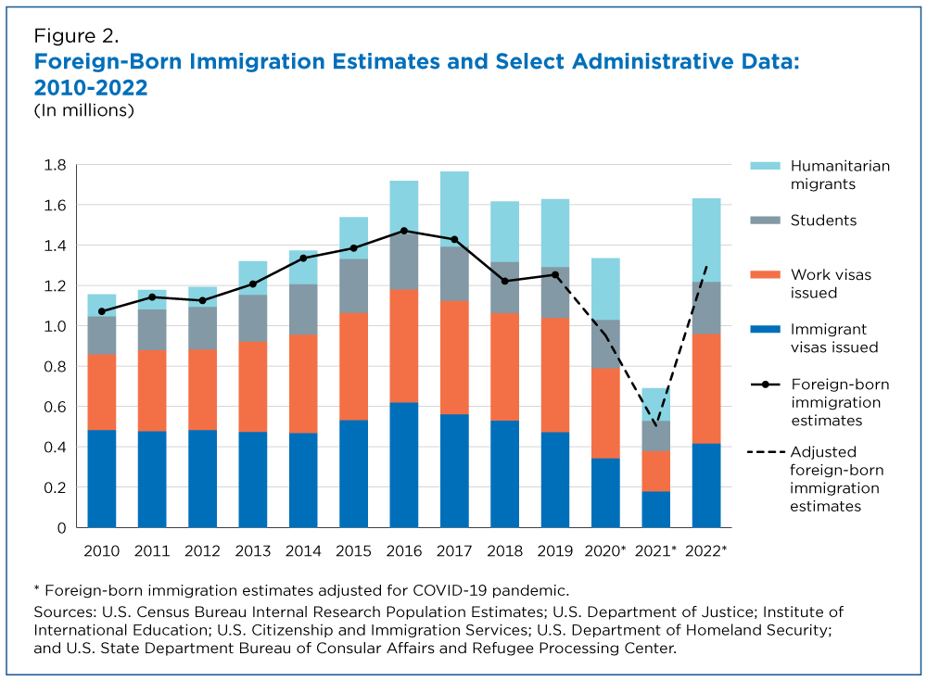
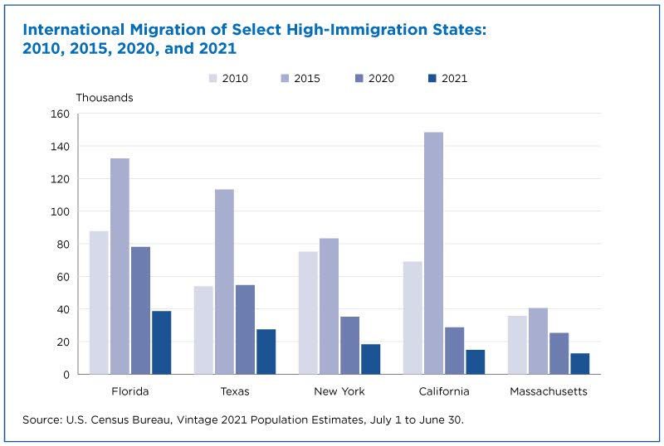
Recent Trends in Foreign Migration
https://www.census.gov/content/dam/Census/library/stories/2021/12/net-international-migration-at-lowest-levels-in-decades-figure-2.jpg
Notes:
Foreign migration is particularly interesting. One interesting fact is that it has been declining in the last few years (especially because of COVID and the Trump Administration policies). This should be revisited with new data. Also some places are mice more desirable for migrants…

Slide 6
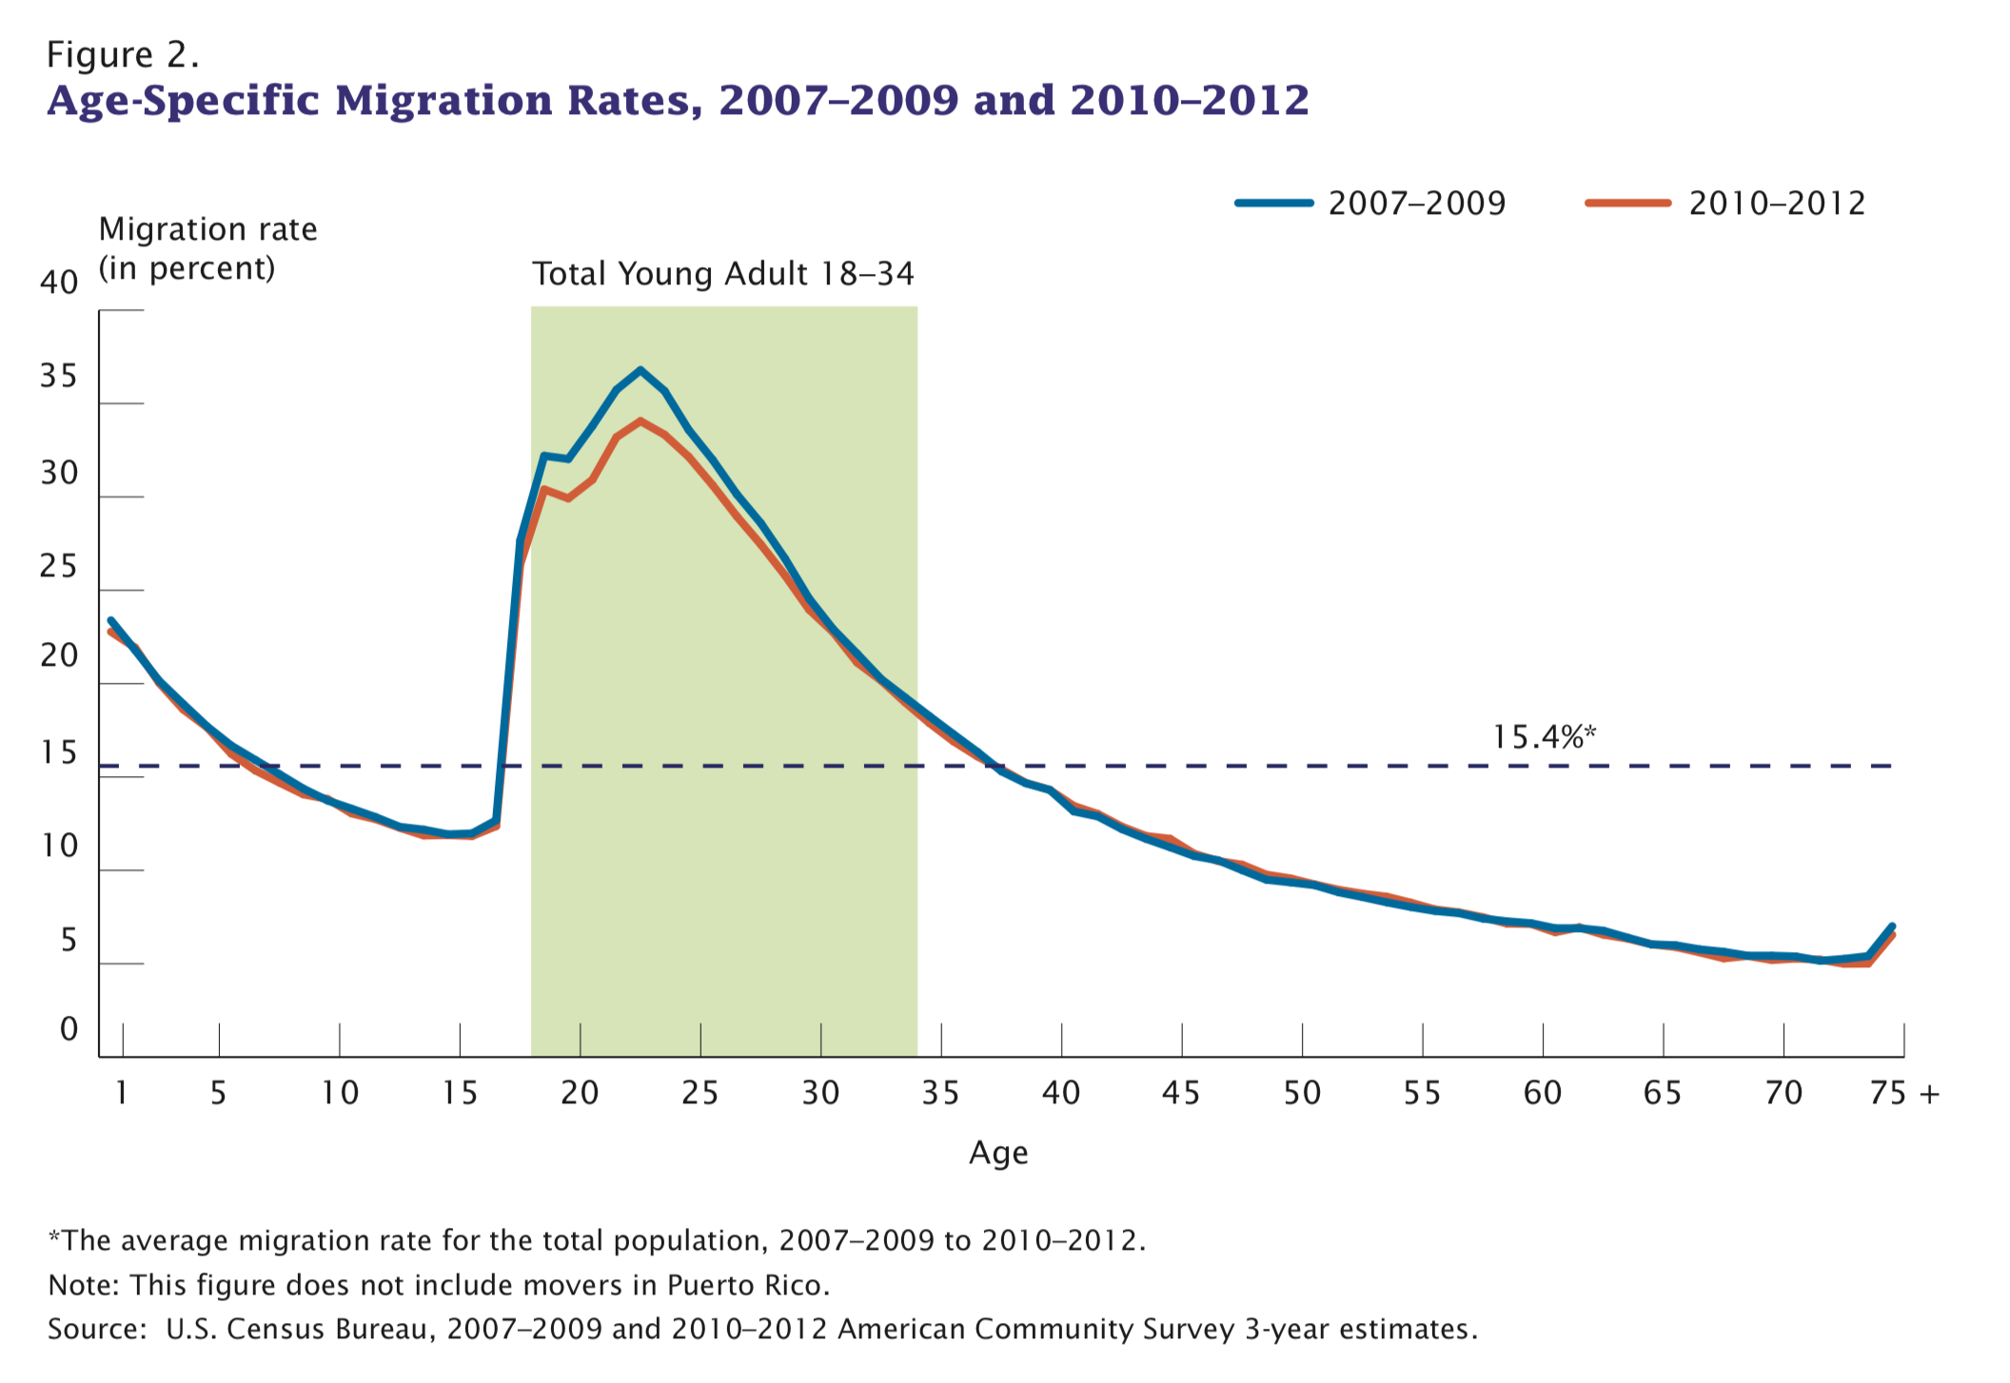
Who Migrates?
This is the most important feature of migration
https://www.census.gov/content/dam/Census/library/publications/2015/acs/acs-31.pdf
Notes:
This is the most important fact about migration. It is young people who migrate. High rates of outmigration deprive origin places of the young, and rejuvenate places of destination. This is a universal result (in relative terms by age).

Slide 7
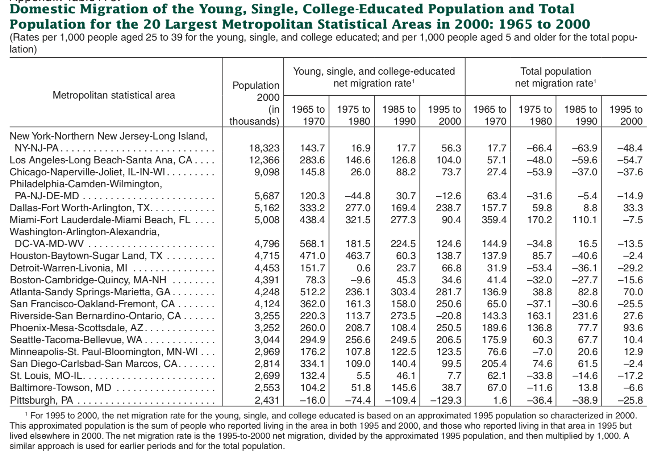
https://usa.ipums.org/usa/resources/voliii/pubdocs/2000/censr-12.pdf
Notes:
But we can look even closer, the migration of the young, single and college educated is particularly informative of cities on an upward and downward direction, it is practically a self-fulfilling prophecy. It would be interesting to see where the young people that once flocked to SF are going now…

Slide 8
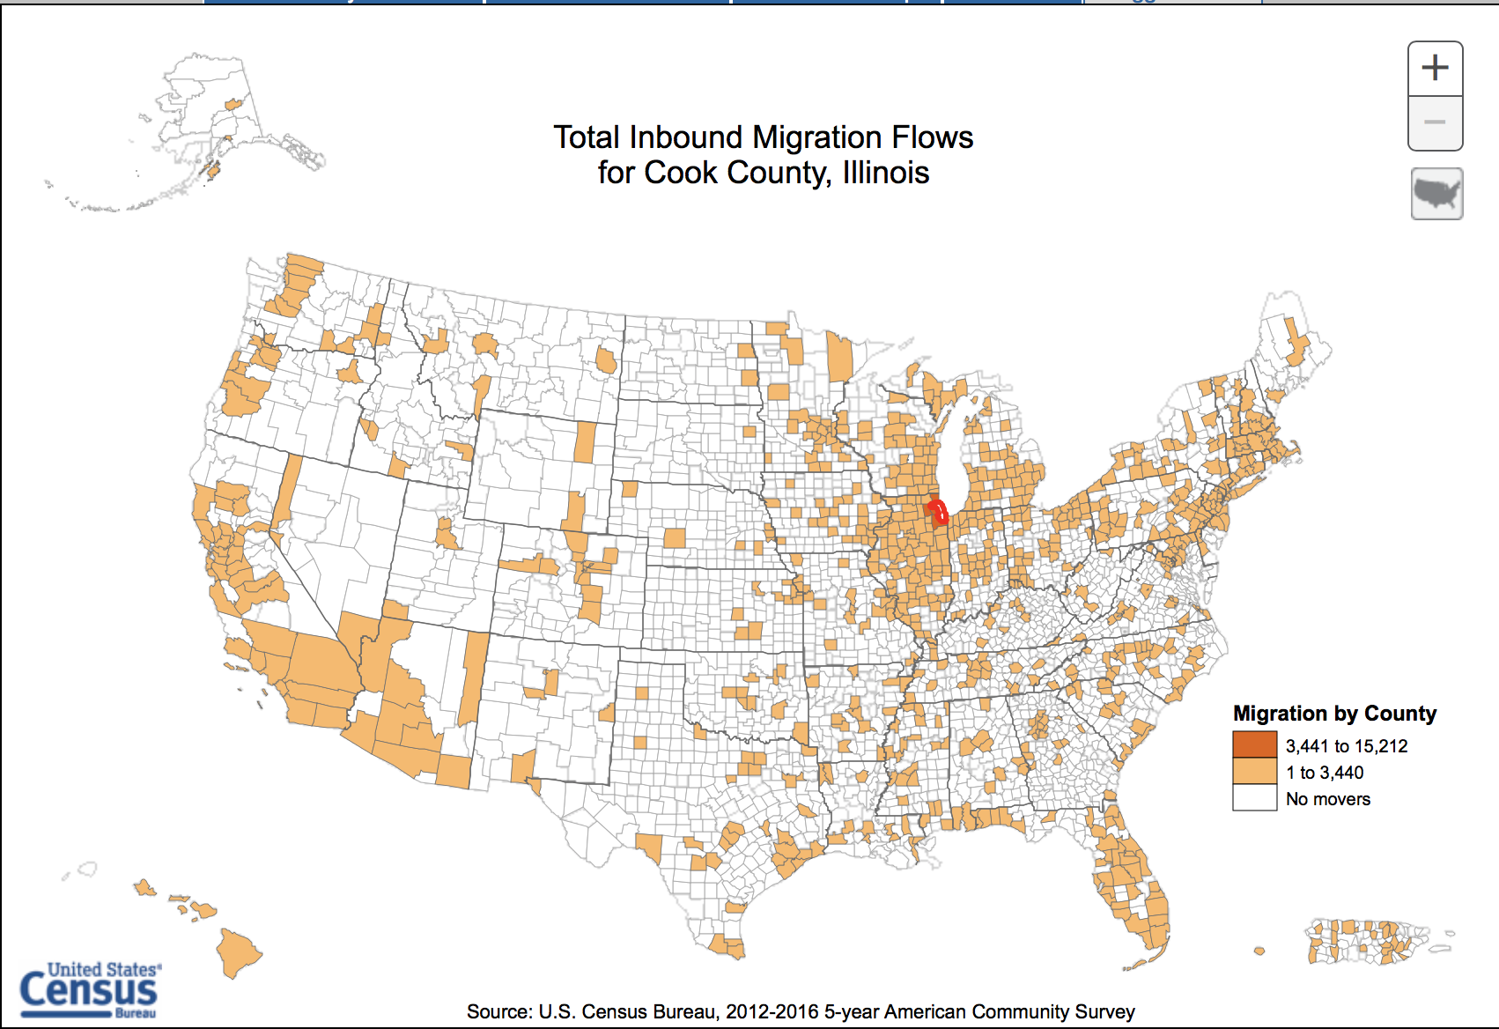
https://flowsmapper.geo.census.gov/map.html
Notes:
When we look more locally (you can do this for your city following the link) you can start seeing where people come from…

Slide 9
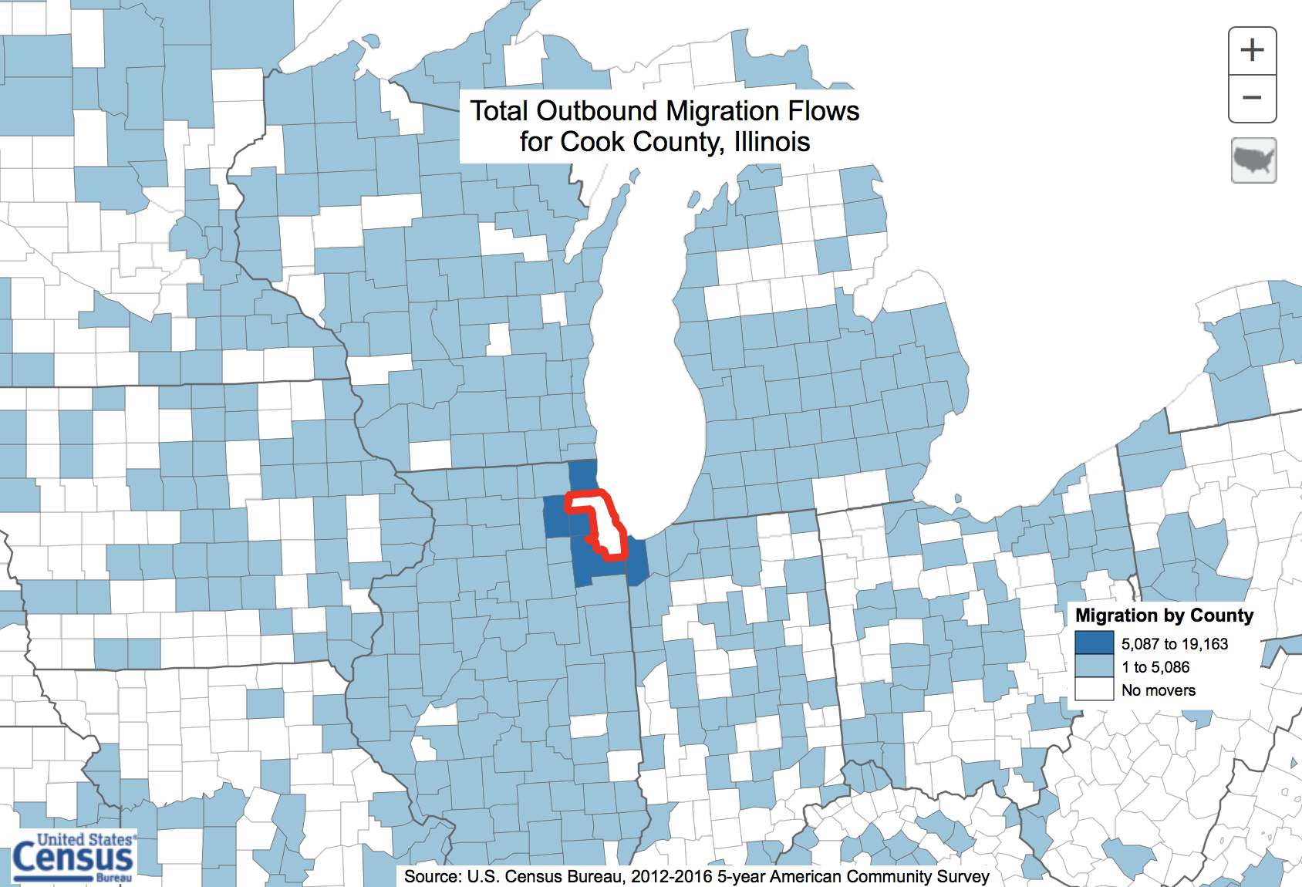
https://www.census.gov/topics/population/migration/guidance/county-to-county-migration-flows.html
Notes:
… and where they go to… In the case of Chicago, it has been suburbanizing for a while. The Metro area has almost 10 million people while the City (~ Cook County) less than 2.8 million. The population peak in the City was about 3.5 million in 1960, around the time cars and highways were introduced and opened up the suburbs. While this may not have been the only reason, the following decades were of great crisis on Chicago.

Slide 10
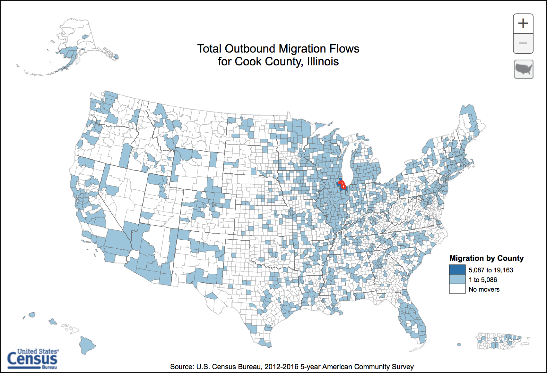
Notes:
And this is where people are going farther out … You can start seeing other cities, as well as Florida, Indiana, and the West.

Slide 11
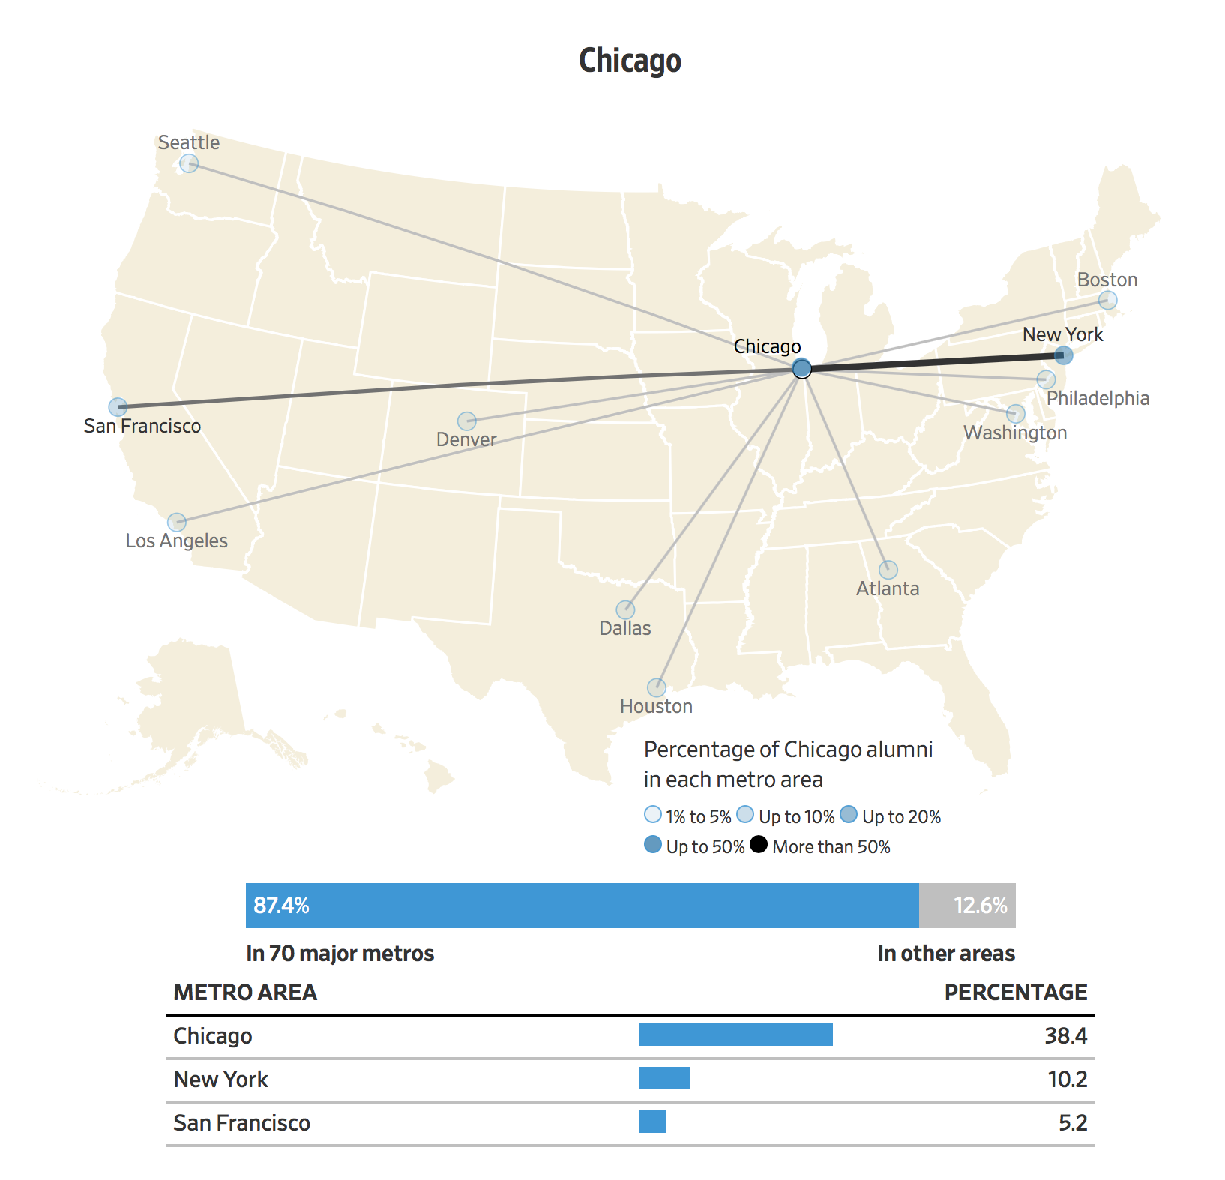

wall street journal survey
Where UChicago Graduates Move After College
https://www.wsj.com/graphics/where-graduates-move-after-college/
Notes:
Just to make it personal, you can also look at where graduates from your University go to when they graduate. Many graduates of UChicago stay in Chicago (but not in the South Side).

Slide 12
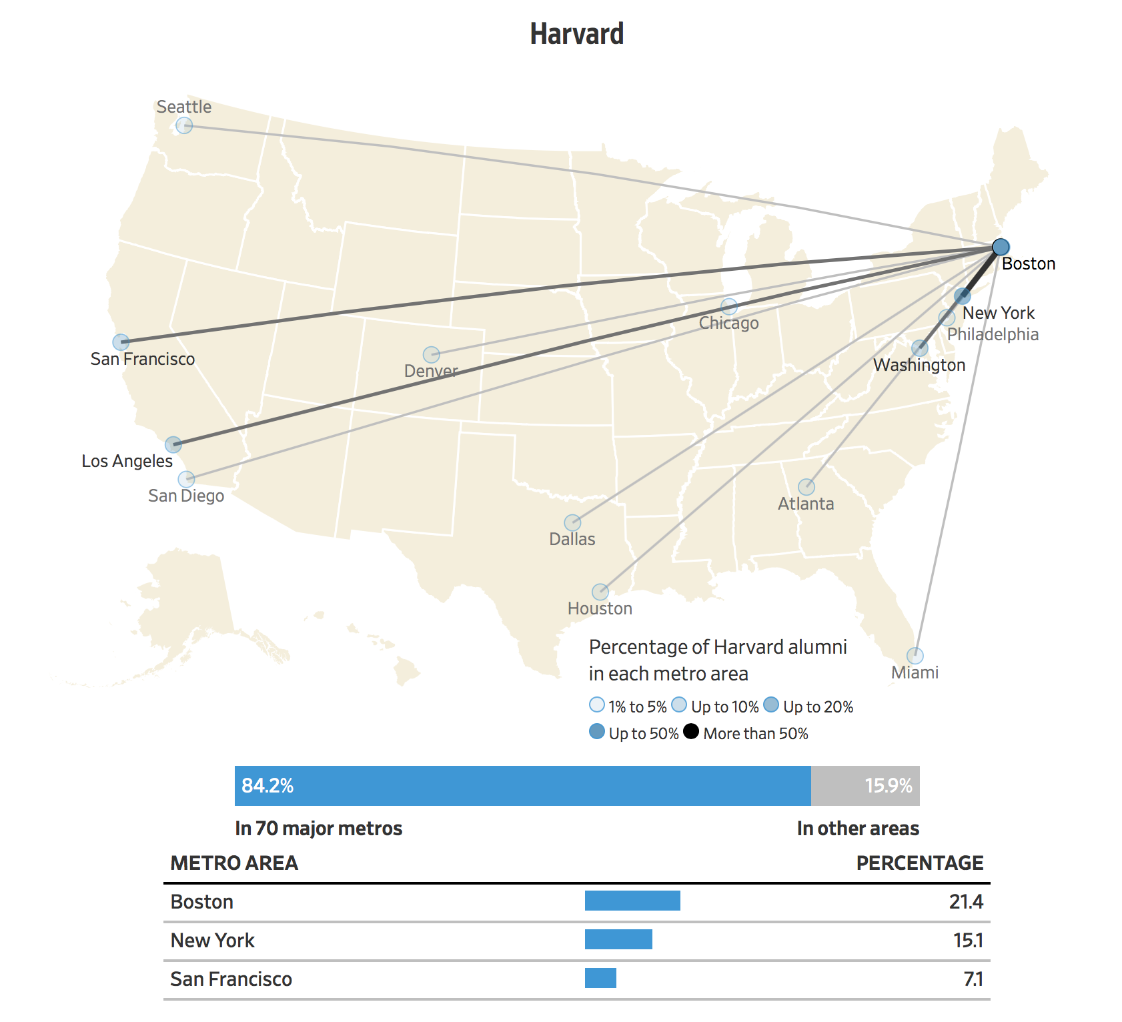
wall street journal
Where Graduates Move After College
https://www.wsj.com/graphics/where-graduates-move-after-college/
Notes:
Less so for Boston viz Harvard… You may be able to look up your School in link provided, though this survey was a while ago…

Slide 13
The Emergence of the Urban System
Mixing
Growth Rates
Strong
Intercity Migration
Gibrat’s Law
all growth rates tend to the same on average
gravity + Zipf’s law
Integrated Urban System
All cities grow together at approximately the same rates
But small differences are very consequent, c.f. Houston/ Atlanta to Chicago or Detroit
Most moves happen for people establishing their adult / professional live
Notes:
OK, so a few lessons: demographic dynamics both grows and “mixes” the population among the cities that make up an urban system. When mixing is strong enough relative to local growth, collective properties of the system (the laws of geography) emerge. These are simple signs of integrated urban systems, though you should consider that there’s a lot more under the hood that these “laws” do not take into account.

